Slide 1
Robotics Lab
Lecture 5: Introduction to ros
Damascus University 2019-2020

Slide 2
ROS (Robotic Operating System)
What & why ros?

Slide 3
What is ROS ?
An open-source, meta-operating system for your robot.
It provides the services you would expect from an operating system, including hardware abstraction, low-level device control, message-passing between processes, … .
It also provides tools and libraries for obtaining, building, writing, and running code across multiple computers.
Source: http://www.ros.org/

Slide 4

What is ROS ?
Meta OS
Robot
Sensor
App

Slide 5
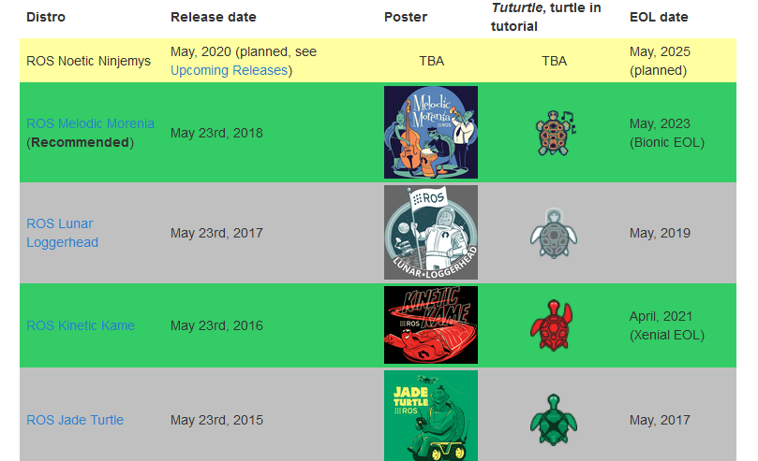
What is ROS ? – ROS Versions
There is a stable
version every 2 years.
Source: http://wiki.ros.org/Distributions

Slide 6
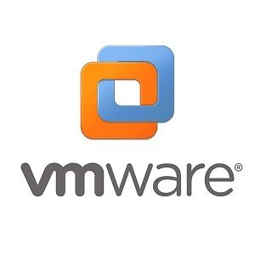

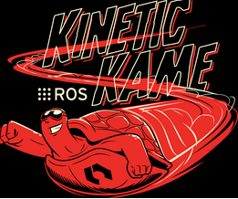
What is ROS ? – ROS Versions
We will use:
Virtual Machine with Ubuntu 16.04 LTS.
ROS Kinetic Kame.

Slide 7
Why ROS ?
Code Reusability (from the main objectives of ROS).
Visualization & simulation tools.
Community.
Continuous Support (Conferences - Documentations …).

Slide 8
Resources

Slide 9
Resources
ROS official documentation: https://wiki.ros.org
Programming Robots with ROS book by Morgan Quigley, Brian Gerkey, and William D. Smart.
ROS Robot Programming book by TurtleBot3 Developers.
“The Construct” channel on YouTube (Robot ignite Academy).

Slide 10
ROS Visualization & Simulation tools
Rviz - gazebo

Slide 11
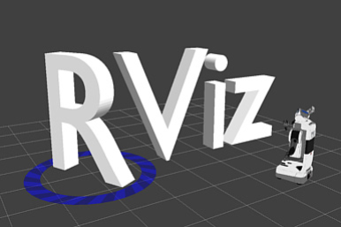
ROS Visualization - RViz
- RViz is the 3D visualization tool of ROS.
- With RViz we can show messages from robot in 3D,
like:
Sensors messages Encoders messages
(Odometry)
Laser Messages …

Slide 12
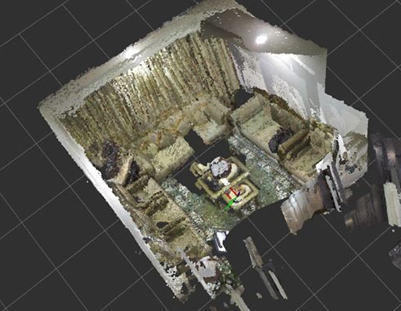
ROS Visualization - RViz
RViz example 1: 3D model by Kinect 360.

Slide 13
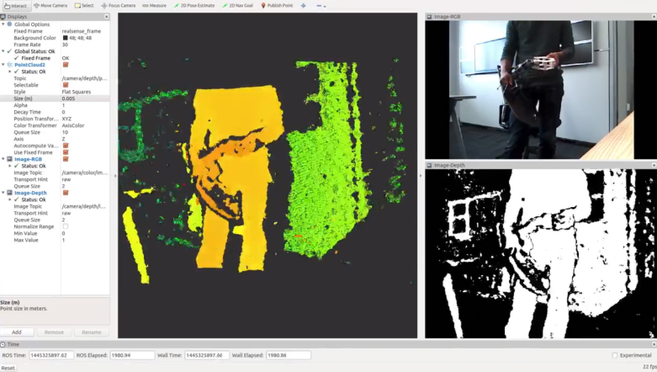
ROS Visualization - RViz
RViz example 2: distance, infrared, color image value obtained from Intel RealSense.
Source: ROS Robot Programming book pp. 132

Slide 14
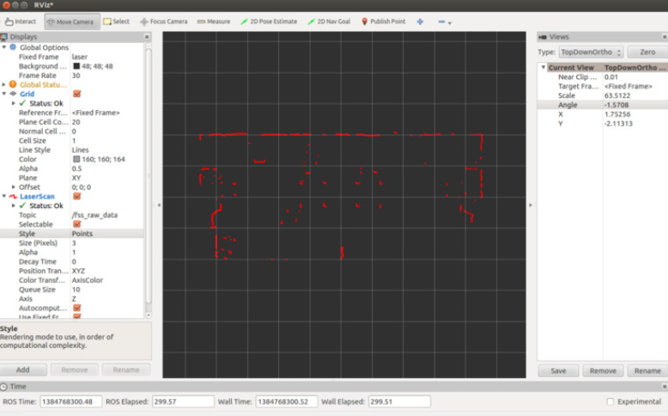
ROS Visualization - RViz
RViz example 3: Measuring distance using Laser Distance Sensor (LDS).
Source: ROS Robot Programming book pp. 131

Slide 15
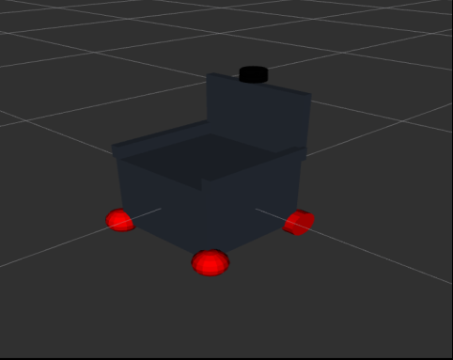
ROS Visualization - RViz
RViz example 4: Visualize Robot Model.
Source: Autonomous wheelchair, Damascus University ITE, Waseem Kntar, Modar Alshamali.

Slide 16
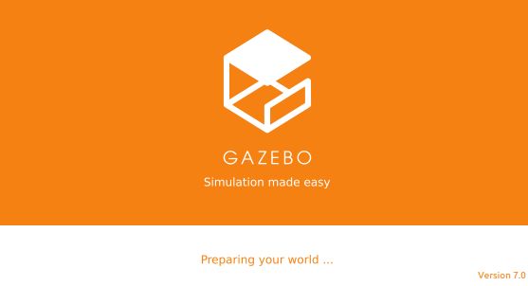
ROS Simulation - Gazebo
- Gazebo is a 3D Simulator.
- We can import or create worlds (environments) and we can also import 3D models to it.
- We can move robot and interact with the environment like any simulator.

Slide 17
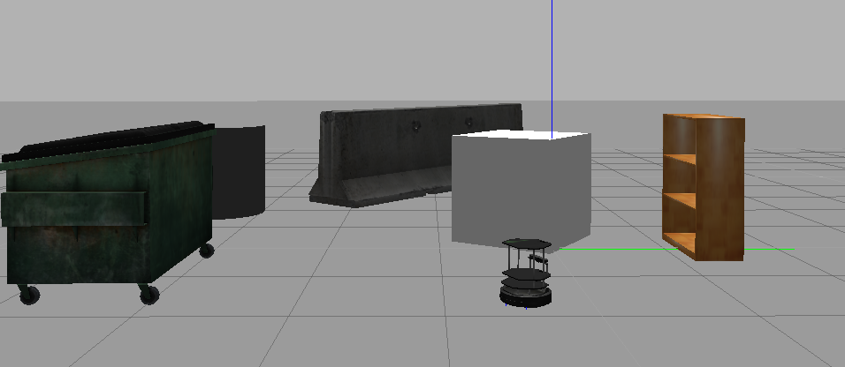
ROS Simulation - Gazebo
Gazebo example: turtlebot

Slide 18
ROS Message Communication
Node - Topic – service – actions – parameter server

Slide 19
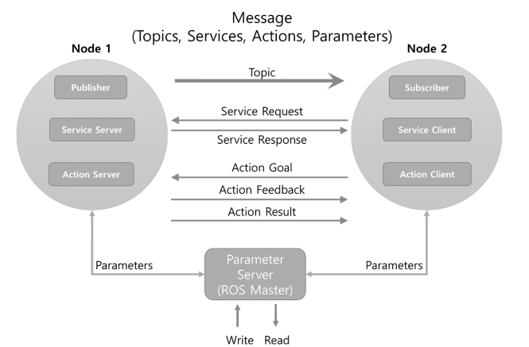
ROS Message Communication
Source: ROS Robot Programming book pp. 50

Slide 20
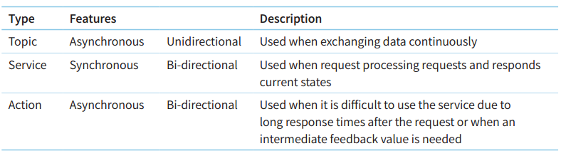
ROS Message Communication
Source: ROS Robot Programming book pp. 50

Slide 21
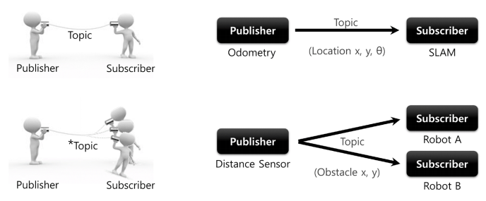
ROS Message Communication
Source: ROS Robot Programming book pp. 51

Slide 22
ROS File System
Workspace & ros files

Slide 23

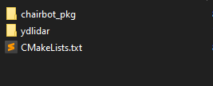
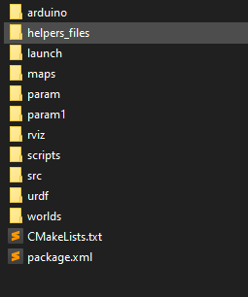
ROS File System
Workspace folder
src folder
package
Source: Autonomous wheelchair, Damascus University ITE, Waseem Kntar, Modar Alshamali

Slide 24
More about ROS Files
Python – urdf – launch – yaml.
Notes:
Live tour in ROS Files

Slide 25
Lets Implement
Create workspace – create node - Read - visualize
Notes:
Odometry or kinect

